Slide 1
UCLA Graduate School Admission from an Indian Perspective
By: Quinton Butterfield, Zelalem Kebede & Itunu Oyeyipo

Slide 2
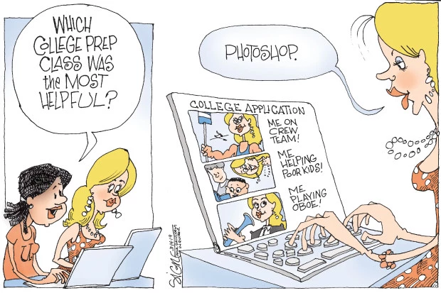

Motivation
Getting a college education from a highly rated university or college is supposed to set you up for a successful career, however the playing field isn’t leveled.
We want to examine top variables needed to gain admission into graduate schools.

Slide 3
Motivation & Summary Slide
Question:
Is it harder to get into highly rated graduate schools?
How much weight is placed on test scores, personal statements, research experience and past performance?
Examination Analysis:
We observed a dataset of 500 applicants of Indian descent applying to UCLA graduate school.
Seven variables:
GRE Scores
TOEFL Scores
Undergraduate University Rating
Statement of Purpose (SOP)
Letter of Recommendation (LOR)
College GPA (CGPA)
Research Experience

Slide 4
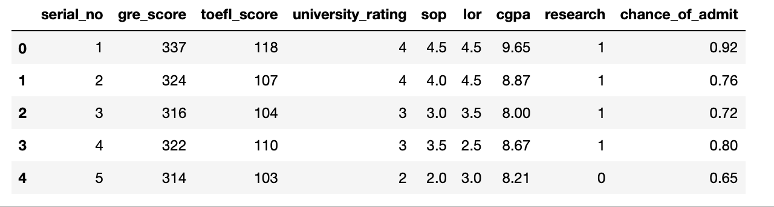
Raw Data

Slide 5
Data Cleanup & Exploration
During our data research process, we encountered some issues with the limitation of the sample population.
We dropped a column that was not relevant to our data.
We didn’t realize that the undergraduate university rating played a factor in the dataset.
We were able to effectively work through the issues by understanding each aspect of the dataset and clarifying amongst ourselves in order to make an educated decision.
As shown in the upcoming slides, jupyter notebook was very effective for the data visualization.

Slide 6
Data Analysis
We use several types of data visualization tool such as:
Scatterplots
Bar Charts
Line Chart
Heatmap
Boxplot

Slide 7
Discussion
Our findings
We observed that the strongest positive correlations was between CGPA, GRE Scores, TOEFL Scores and Chance of admission into UCLA graduate school.
We saw a strong correlation between CGPA and GRE score - people who scored high on one probably scored high on the other.
We saw a strong correlation between TOEFL and GRE score - people who scored high on one probably scored high on the other.
We can also infer that there is a weak correlation between research experience and chance of admission.
There is an inference that the rating of the applicants undergraduate college had an impact on chance of admission.

Slide 8
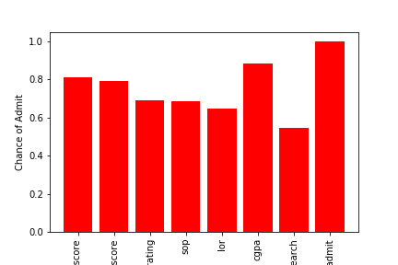
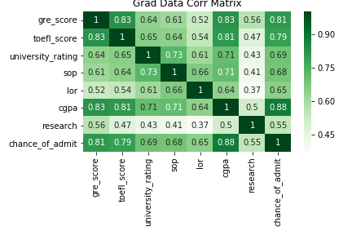
Correlation of variables
We chose to focus on CGPA, GRE score and TOEFL score. This is because after creating the following correlation visuals, these were the one that appeared to have the highest positive correlation to chance of admission into UCLA.

Slide 9
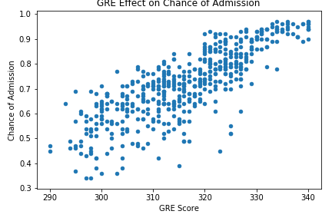
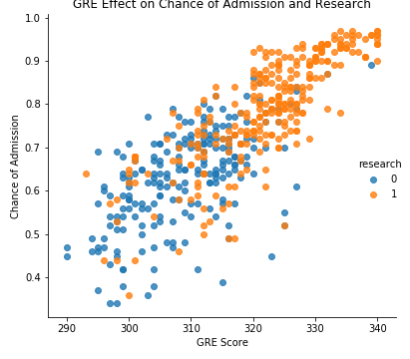
Questions & Data
Question:
How does GRE Scores influence the chance of admission?

Slide 10
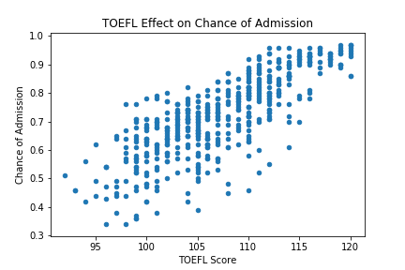
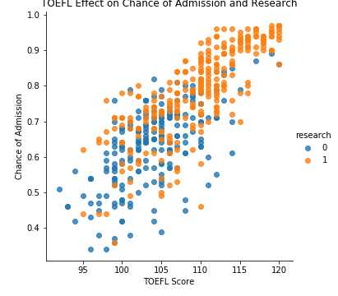
Questions & Data
Question:
How does TOEFL Scores influence the chance of admission?

Slide 11
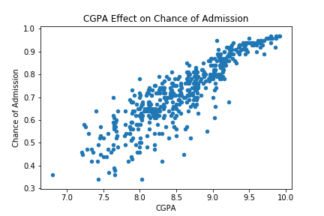
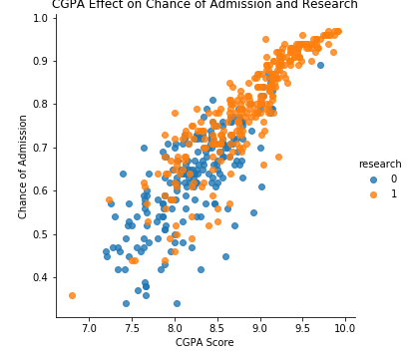
Questions & Data
Question:
How does CGPA influence the chance of admission?

Slide 12
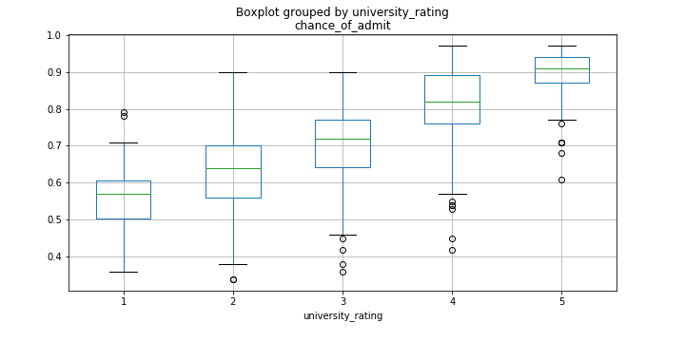
Analysis of Variance - College Ratings
Analysis of variance (ANOVA) is a collection of statistical models and their associated estimation procedures (such as the "variation" among and between groups) used to analyze the differences among group means in a sample.
Null Hypothesis(H₀): All graduate applicants from differently rated colleges have the same chance of admission into UCLA graduate school.
Alternative Hypothesis(H₁): Not all graduate applicants from differently rated colleges have the same chance of admission into UCLA graduate school.
The P-value is 7.75e-69 so we will reject null hypothesis. This means that the difference in admission between rating groups differs significantly from the difference in admission between members within in each rating group.

Slide 13
Post Mortem
Difficulties that arose
Limitation of the type of sample population observed.
Lack of clarity on how the sample was obtained
Limitation on the variables selected
How university rating was determined
Areas of improvement
The study could observe differences amongst other applicants
Age
Previous graduate experience
Expand the study to other highly rated graduate schools

Slide 14
Data & References
All analysis and visualization was performed in jupyter notebook. The full annotated scripts and results are posted at: https://github.com/ItunuOye/Project1
Resource
(1) Mohan S Acharya, Asfia Armaan, Aneeta S Antony : A Comparison of Regression Models for Prediction of Graduate Admissions, IEEE International Conference on Computational Intelligence in Data Science 2019
Additional resources
https://cgsnet.org/graduate-enrollment-and-degrees
https://www.prepscholar.com/gre/blog/graduate-school-acceptance-rates/

Slide 15
Questions
Any questions??

